Slide 1


ARTIFICIAL INTELIGENCE
OVERVIEW

Slide 2

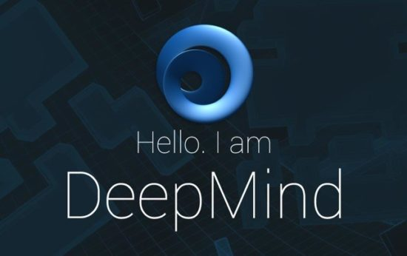
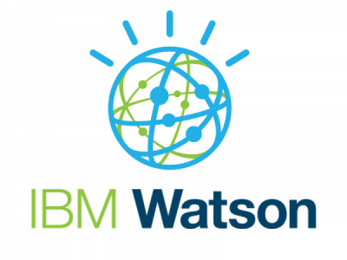
1010101010101010101010101010101010101010101010101010101010101010
1010101010101010101010101010101010101010101010101010101010101010
1010101010101010101010101010101010101010101010101010101010101010
1010101010101010101010101010101010101010101010101010101010101010
1010101010101010101010101010101010101010101010101010101010101010
1010101010101010101010101010101010101010101010101010101010101010
1010101010101010101010101010101010101010101010101010101010101010
1010101010101010101010101010101010101010101010101010101010101010
101010101010101010101010101010101010101010101010101010101010101010101010101
101010101010101010101010101010101010101010101010101010101010101010101010101
101010101010101010101010101010101010101010101010101010101010101010101010101
101010101010101010101010101010101010101010101010101010101010101010101010101
101010101010101010101010101010101010101010101010101010101010101010101010101
101010101010101010101010101010101010101010101010101010101010101010101010101
101010101010101010101010101010101010101010101010101010101010101010101010101
10101010101010101010101010101010101010101010101010
1010101010101010101010101
SINCE THE VERY BEGINNING OF 2016, ARTIFICIAL INTELLIGENCE OR AI HAS MADE INCREDIBLE PROGRESS..
1010101010101010101010101010101010101010101010101010101010101010
1010101010101010101010101010101010101010101010101010101010101010
1010101010101010101010101010101010101010101010101010101010101010
1010101010101010101010101010101010101010101010101010101010101010
1010101010101010101010101010101010101010101010101010101010101010
1010101010101010101010101010101010101010101010101010101010101010
1010101010101010101010101010101010101010101010101010101010101010
1010101010101010101010101010101010101010101010101010101010101010
From the machine learning system of Uber and Grab
To Google’s DeepMind AI
To IBM Watson’s AI
1010101010101010101010101010101010101010101010101010101010101010
1010101010101010101010101010101010101010101010101010101010101010
1010101010101010101010101010101010101010101010101010101010101010
1010101010101010101010101010101010101010101010101010101010101010
1010101010101010101010101010101010101010101010101010101010101010
1010101010101010101010101010101010101010101010101010101010101010
1010101010101010101010101010101010101010101010101010101010101010
1010101010101010101010101010101010101010101010101010101010101010
AlphaGo
Tesla AI
Siri
Amazon Alexa
And the list goes on..
1010101010101010101010101010101010101010101010101010101010101010010101010101010101010100

Slide 3
1010101010101010101010101010101010101010101010101010101010101010
1010101010101010101010101010101010101010101010101010101010101010
1010101010101010101010101010101010101010101010101010101010101010
1010101010101010101010101010101010101010101010101010101010101010
1010101010101010101010101010101010101010101010101010101010101010
1010101010101010101010101010101010101010101010101010101010101010
1010101010101010101010101010101010101010101010101010101010101010
1010101010101010101010101010101010101010101010101010101010101010
101010101010101010101010101010101010101010101010101010101010101010101010101
101010101010101010101010101010101010101010101010101010101010101010101010101
101010101010101010101010101010101010101010101010101010101010101010101010101
101010101010101010101010101010101010101010101010101010101010101010101010101
101010101010101010101010101010101010101010101010101010101010101010101010101
101010101010101010101010101010101010101010101010101010101010101010101010101
101010101010101010101010101010101010101010101010101010101010101010101010101
10101010101010101010101010101010101010101010101010
1010101010101010101010101
THE WORLD IS ALREADY EMBRACING AI AND MANY BUSINESSES ARE CURRENTLY BEING AFFECTED BY ITS ADVANCEMENT
1010101010101010101010101010101010101010101010101010101010101010
1010101010101010101010101010101010101010101010101010101010101010
1010101010101010101010101010101010101010101010101010101010101010
1010101010101010101010101010101010101010101010101010101010101010
1010101010101010101010101010101010101010101010101010101010101010
1010101010101010101010101010101010101010101010101010101010101010
1010101010101010101010101010101010101010101010101010101010101010
1010101010101010101010101010101010101010101010101010101010101010
The following statistics indicate exactly how big the impact of AI is going to be in the near future:
85%
$1.5B
16%
1010101010101010101010101010101010101010101010101010101010101010
1010101010101010101010101010101010101010101010101010101010101010
1010101010101010101010101010101010101010101010101010101010101010
1010101010101010101010101010101010101010101010101010101010101010
1010101010101010101010101010101010101010101010101010101010101010
1010101010101010101010101010101010101010101010101010101010101010
1010101010101010101010101010101010101010101010101010101010101010
1010101010101010101010101010101010101010101010101010101010101010
of customer interactions are projected to be managed without a human involvement by 2020 (Gartner)
billion were invested in AI as of May 2016 (CB Insights)
of American jobs will be replaced by AI by the end of the decade (Forrester)
1010101010101010101010101010101010101010101010101010101010101010010101010101010101010100

Slide 4







1010101010101010101010101010101010101010101010101010101010101010
1010101010101010101010101010101010101010101010101010101010101010
1010101010101010101010101010101010101010101010101010101010101010
1010101010101010101010101010101010101010101010101010101010101010
1010101010101010101010101010101010101010101010101010101010101010
1010101010101010101010101010101010101010101010101010101010101010
1010101010101010101010101010101010101010101010101010101010101010
1010101010101010101010101010101010101010101010101010101010101010
101010101010101010101010101010101010101010101010101010101010101010101010101
101010101010101010101010101010101010101010101010101010101010101010101010101
101010101010101010101010101010101010101010101010101010101010101010101010101
101010101010101010101010101010101010101010101010101010101010101010101010101
101010101010101010101010101010101010101010101010101010101010101010101010101
101010101010101010101010101010101010101010101010101010101010101010101010101
101010101010101010101010101010101010101010101010101010101010101010101010101
10101010101010101010101010101010101010101010101010
1010101010101010101010101
Artificial Intelligence is becoming a priority
COMPANIES ARE BEGINNING TO INVEST IN AI CAPABILITIES
“…the next wave of solutions will gather unprecedented amounts of data from disparate systems and—by weaving systems, data, and people together—create solutions…”
“Smart Machine Technologies Will Render the Offshore Model Obsolete for Competitive Advantage”
“Davos: Smart machines set to transform society”
1010101010101010101010101010101010101010101010101010101010101010
1010101010101010101010101010101010101010101010101010101010101010
1010101010101010101010101010101010101010101010101010101010101010
1010101010101010101010101010101010101010101010101010101010101010
1010101010101010101010101010101010101010101010101010101010101010
1010101010101010101010101010101010101010101010101010101010101010
1010101010101010101010101010101010101010101010101010101010101010
1010101010101010101010101010101010101010101010101010101010101010
1010101010101010101010101010101010101010101010101010101010101010010101010101010101010100

Slide 5
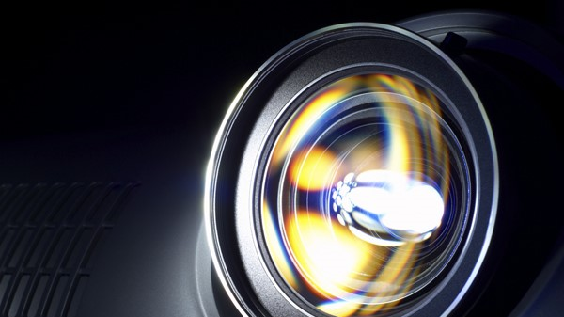
ARTIFICIAL INTELIGENCE

Slide 6
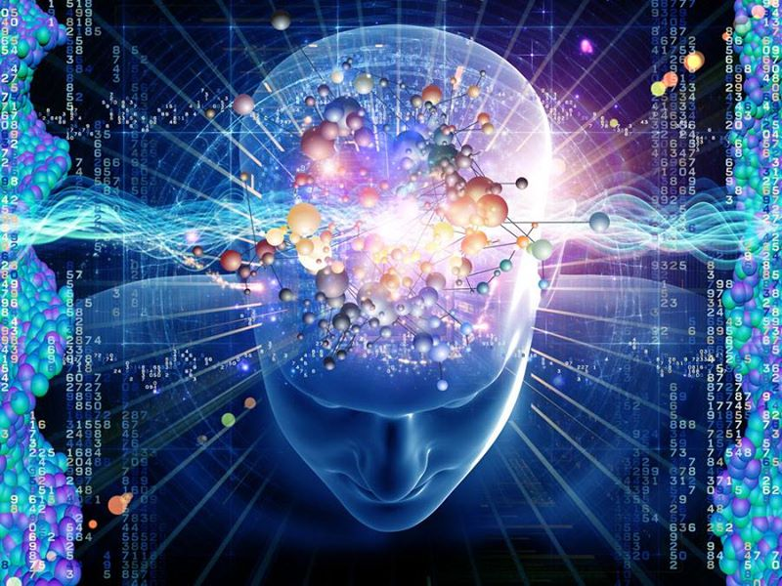
WHAT IS ARTIFICIAL INTELLIGENCE ?
According to the father of Artificial Intelligence, John McCarthy,
AI is the science and engineering of making intelligent machines, especially intelligent computer programs.
It is a way of making a computer, a computer-controlled robot, or a software think intelligently, in the similar manner the intelligent humans think.
It’s describing the brain, not the body, of intelligent machines (AI ≠ robots). The AI of today can do specific tasks (driving a car, booking meetings, picking your next Netflix binge). AI research is leading toward something more advanced: artificial general intelligence, or AGI.

Slide 7
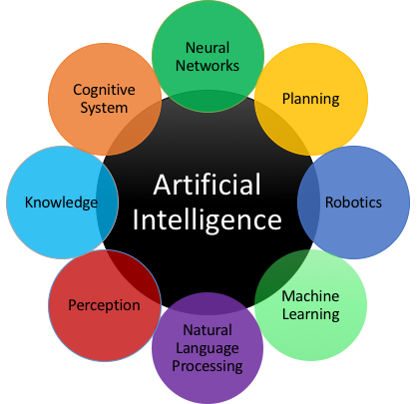
WHAT ARE THE GOALS OF AI?
Humans are considered intelligent species because we are able to perceive the real world, act to it effectively and build new world as we see it.
Machines don’t have these capabilities yet.
Hence, the main goals of AI research include reasoning, knowledge, planning, learning, natural language processing, perception and the ability to move and manipulate objects. General intelligence is among the field's long-term goals

Slide 8
AI – ACCENTURE FOCUS AREAS
Structure & Activities:
AI Governance Council
AI Center of Excellence
AI Community of Practice
MIT Alliance on AI
Accenture Summit on Business Impact of AI
Accenture AI Ideation Challenge
Emerging Technology
Cognitive Robots
Video & Identity Analytics
IBM Watson
IPSoft Amelia
Analytics / Digital
Accenture Digital Assistant Platform & Deep Learning
IBM Watson
Tech Labs
Accenture Text Analyzer
Accenture cognitive Engine
Intelligent Enterprise
Open Innovation
AI Start-Ups

Slide 9
MACHINE LEARNING
DEEP LEARNING

Slide 10
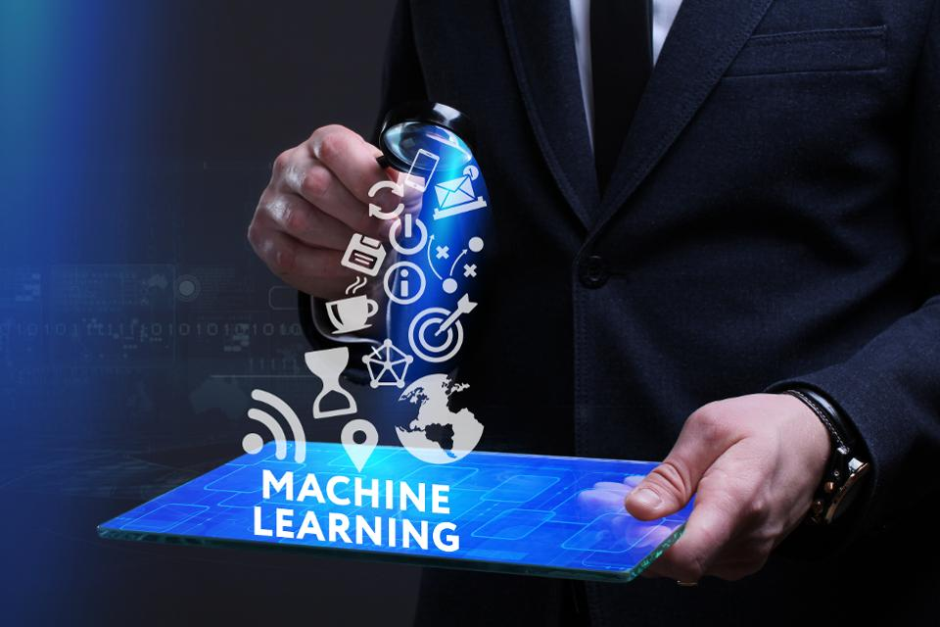
MACHINE LEARNING
MACHINE LEARNING (ML) is an important branch of Artificial Intelligence (AI) that deals with the problem of extracting features from data to solve different predictive tasks:
Forecasting (e.g. energy demand prediction, finance)
Input of missing data (e.g. Netflix recommendations)
Detecting anomalies (e.g. security, fraud, virus mutations)
Classification (e.g. credit risk assessment, cancer diagnosis)
Ranking (e.g. google search, personalization)
Summarizing (e.g. news zeitgeist, social media sentiment)
Decision making (e.g. AI, robotics, compiler tuning, trading)

Slide 11
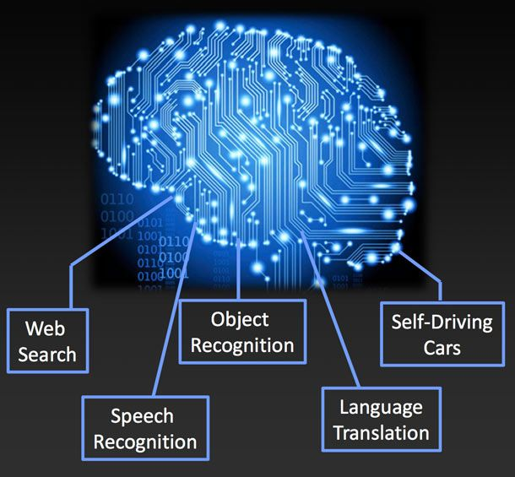
WHY IS MACHINE LEARNING IMPORTANT?
ML algorithms are applicable when:
• Human expertise is absent (e.g. navigating on Mars)
• Humans are unable to explain their expertise (e.g. speech recognition, vision, language)
• Solution changes with time (e.g. tracking, temperature control, preferences)
• Solution needs to be adapted to particular cases (e.g. biometrics, personalization)
• The problem size is too vast for our limited reasoning capabilities (e.g. calculating webpage ranks, matching ads to Facebook pages)

Slide 12
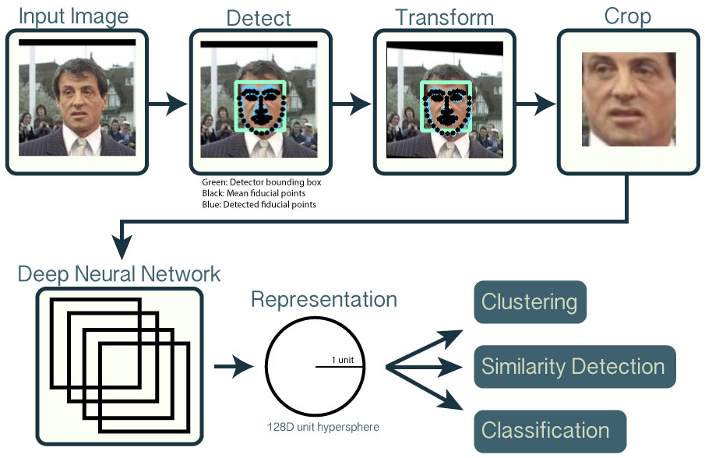
MACHINE LEARNING – DEEP LEARNING
Deep learning is a branch of machine learning where artificial neural networks — algorithms inspired by the way neurons work in the brain — find patterns in raw data by combining multiple layers of artificial neurons.
As the layers increase, so does the neural network’s ability to learn increasingly abstract concepts.
For example, neural networks can learn how to recognize human faces. How? The first layer of neurons takes pixels from example images, the next layers learn the concept of how pixels form an edge, then that layer passes that knowledge to other layers, combining that knowledge of edges to learn the concept of a face. This process of layering knowledge continues until the neural network algorithms recognize specific features, and ultimately specific faces.

Slide 13
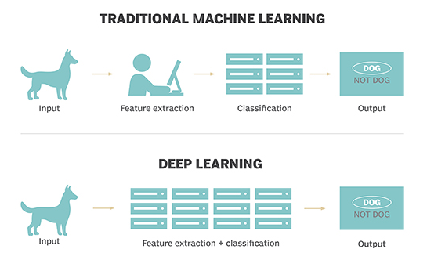
MACHINE LEARNING vs. DEEP LEARNING
In traditional machine learning, the learning process is supervised and the programmer has to be very, very specific when telling the computer what types of things it should be looking for when deciding if an image contains a dog or does not contain a dog.
This is a laborious process called feature extraction and the computer’s success rate depends entirely upon the programmer’s ability to accurately define a feature set for "dog."
The advantage of deep learning is that the program builds the feature set by itself without supervision. This is not only faster, it is usually more accurate.

Slide 14



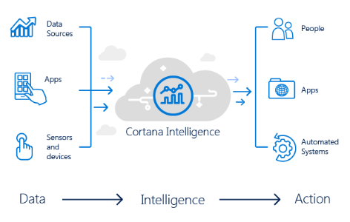
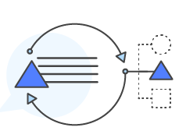
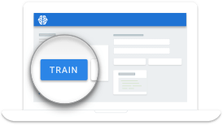


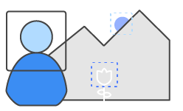


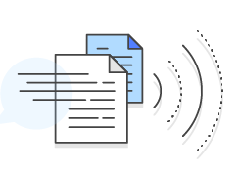


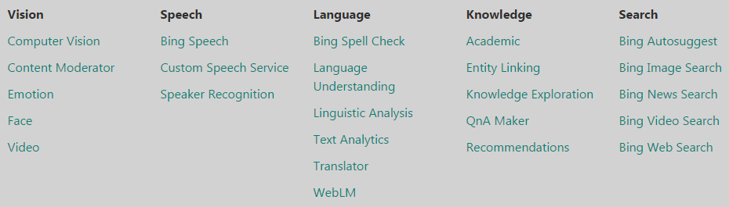

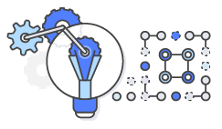


MAJOR PLATFORMS ARE OFFERING DEEP LEARNING ALGORITHMS AND HIGH PERFORMANCE COMPUTE
Large Scale ML
Video Analysis
Image Analysis
Speech Recognition
Text Analysis
Translation

Slide 15
NATURAL LANGUAGE PROCESSING
INTELLIGENT
AGENTS
ROBOTICS

Slide 16


NATURAL LANGUAGE PROCESSING
NLP is a field of Computer Science which covers Artificial Intelligence and Computational Linguistics, and solves challenges to reduce the friction between human and machine interactions.
NLP-based systems are becoming very important in business analytics, consumer-centric analytics and processing of Big Data.
There are two tasks for NLP systems:
Natural Language Comprehension: Extracting meaning from spoken/typed sentences.
Natural Language Generation: Expressing a formal representation of a message in a natural (human) language
NLP
Natural Language Comprehension
Logic
Translates the message meaning into an executable task. (i.e. execute a search, run a function)
Asks for additional information when needed
Natural Language Generation
Back End System

Slide 17
NATURAL LANGUAGE UNDERSTANDING - EXAMPLES
Document processing and automated Information Retrieval – IR is an important market (mainly used by search companies like Google, Yahoo!).
Question & Answering – NLP helps virtual agents (such as Watson Advisor, IPSoft Amelia, Apple’s SIRI) to comprehend and answer natural language questions.
Analysis of medical reports, narratives, Patient history etc. – Mayo Clinic and Stanford University researchers have been using NLP for extracting and discovering insights hidden in medical reports
Customer feedback, sentiment and opinion analysis – large application areas with companies world over implementing to find product sentiments, customer satisfaction analysis
Machine Translation - Language translation through machines is another commercial area of NLP and machine Learning adoption

Slide 18
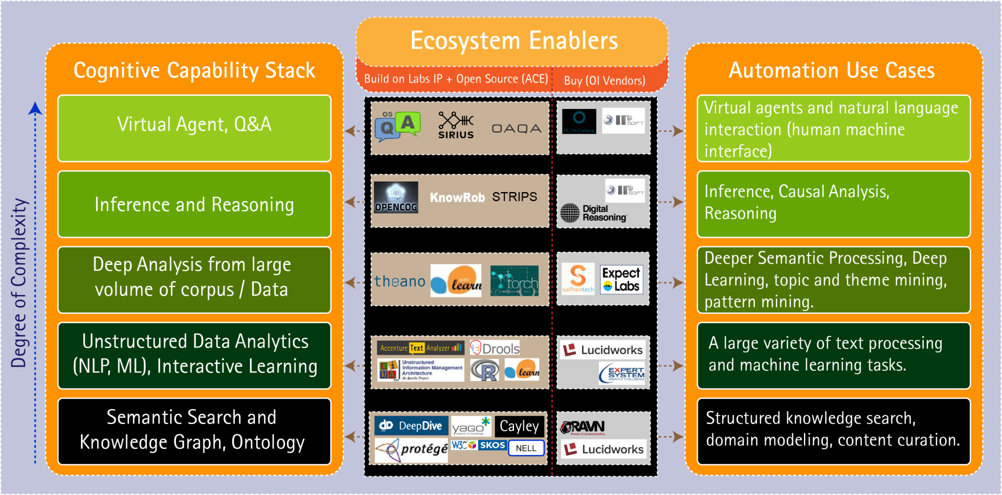
ACCENTURE COGNITIVE AGENT (ACE)
AI Platform asset developed, please see the NLP learning board for applications: Natural Language Processing Learning Board

Slide 19











INTELLIGENT AGENTS
INTELLIGENT AGENT is a family of cognitive computing solutions which can automate human labor
Intelligent Agents
Virtual Assistants for Personal Computing
Natural Language Question Answering
Virtual Service-Desk Assistant
Interactive characters with human-like traits and communication styles. Virtual Agents can answer questions and perform business processes.
Uses
Uses
A new UI: the “new keyboard”
Expert help: a new way to retrieve information
Replaces/helps back-office employees
Siri
Watson
IPsoft
Cortana
Personal Assistant for Google software that uses Google’s Knowledge Graph to answer questions. Therefore it is both an assistant and a question answerer
EasyAsk’s Quiri answers CRM, ERP & Business Intelligence questions asked in natural language.
NextIT
Wolfram Alpha
Silvia
IPsoft
Nina
Artificial Solutions

Slide 20
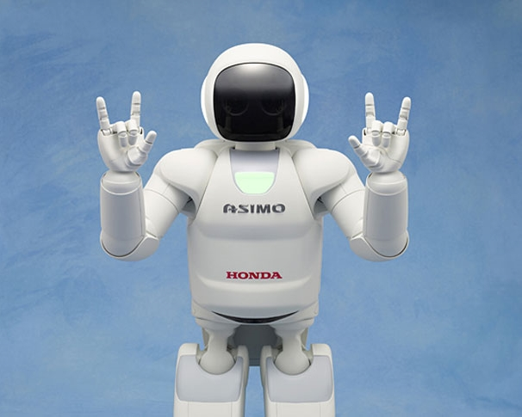
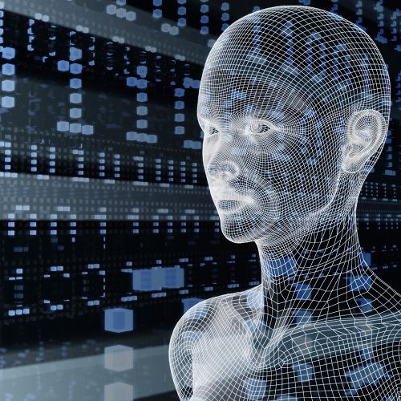
ROBOTICS
Robotics come in different forms – they can be software and/or hardware (physical) based. AI is providing disrupting forces:
Sense | Think | Act | Collaborate / Cooperate
Physical Robotics can be viewed as humanoids, drones, manufacturing arms – anything physical beyond the PC. AI plays a significant role in enhancing the operating features, such as navigation and Deep Learning for vision and control
Accenture Cognitive Robotics solution uses computer vision to automate capture or execution of repetitive and manually intensive knowledge work activities on PCs
RPA (Robotic Process Automation) is a term for an application that replaces human actions in a system i.e. SAP data entry

Slide 21
IoT devices

Slide 22
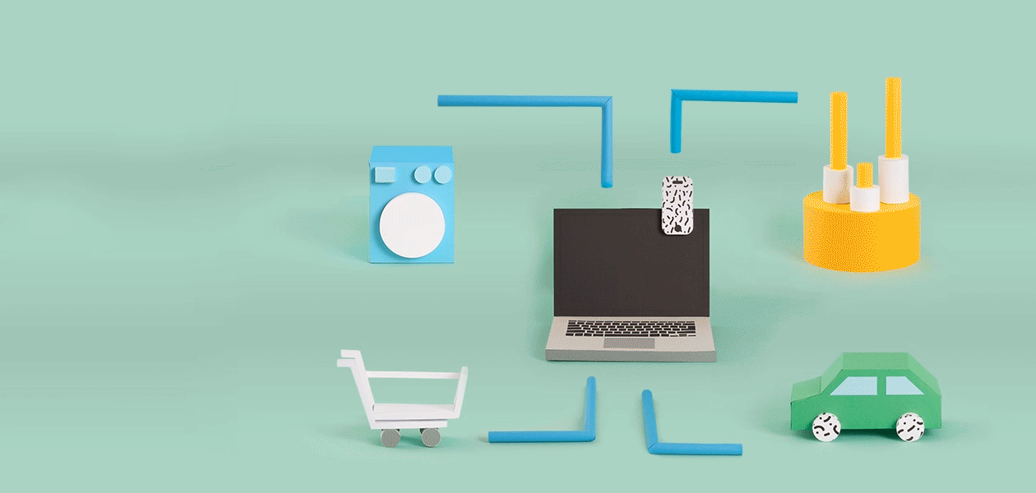
WHAT IS INTERNET OF THINGS?
The Internet of Things (IoT) is a system of interrelated computing devices, mechanical and digital machines, objects, animals or people that are provided with unique identifiers and the ability to transfer data over a network without requiring human-to-human or human-to-computer interaction.

Slide 23



WHAT IS INTERNET OF THINGS?

Slide 24

RASPBERRY PI
Credit card sized computer
Developed in U.K by Raspberry Pi Foundation in 2009
Project initiated by Eben Upton
Based on Broadcom chips
Supported by UCCL and Broadcom
Affordable
Runs in Linux & Windows 10
Consumes less than 5W of power
Supports full HD video output (1080p), multiple USB ports etc.

Slide 25
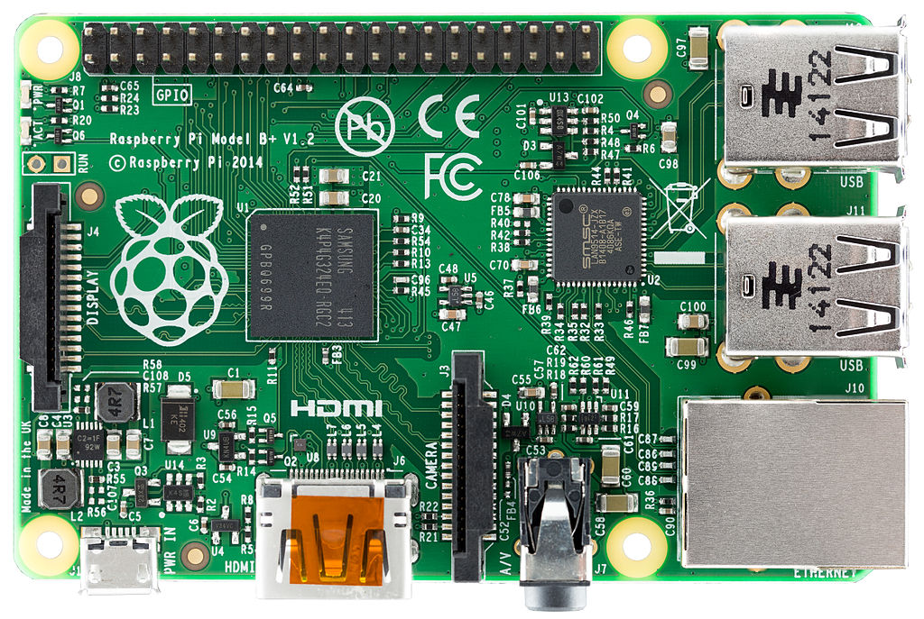
RASPBERRY PI
40 PINS extended GPIO
Dimensions 85.6mm x 56mm x 21mm
On-board Bluetooth and WIFI
BCM2837 64bit CPU at 1.2 GHz and 1GB RAM
4 x USB Ports
Micro SD slot
DSI display port
LAN PORT
Micro USB power input.
Upgraded switch power source that can handle up to 2.5 amps
Full size HDMI video output
3.55mm 4-pole composite video and audio output jack
CSI Camera port

Slide 26
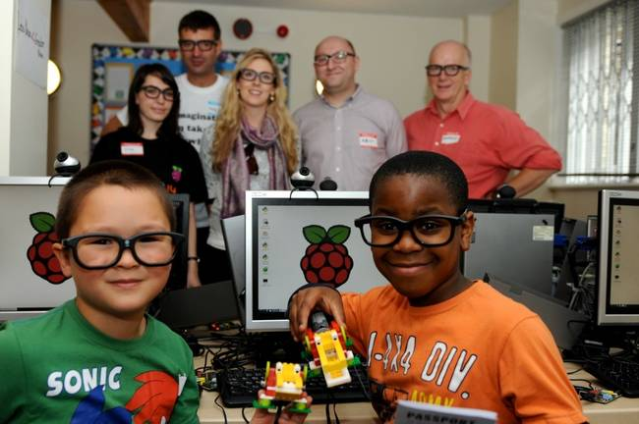
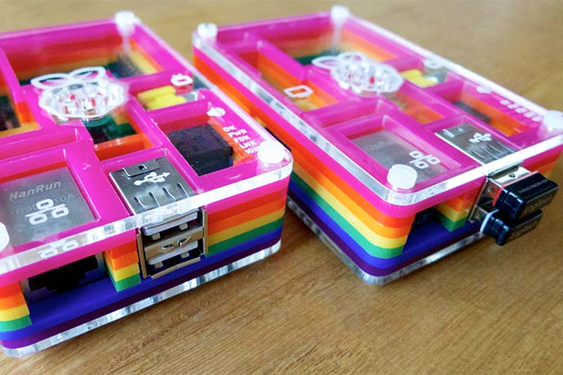
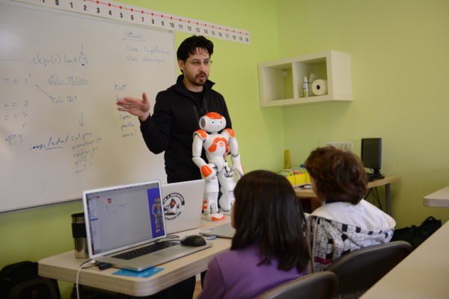
RASPBERRY PI
For developing CS skills especially for kids.
Limited access to computers
Computers are the tool of 21st century
Computer science is concerned with much more than simply being able to use a computer.
Children should understand how they work and how to program them.

Slide 27
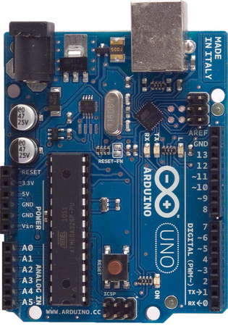
ARDUINO
USB plug
External power supply
ATmega328 microcontroller
Analog reference pin
Digital ground
3.3 volt power pin
Reset pin
5 volt power pin
Ground pins
Digital I/O pins (2-13)
Voltage in
Analog in pins
(0-5)
Reset button
Serial Out (TX)
Serial Out (RX)

Slide 28
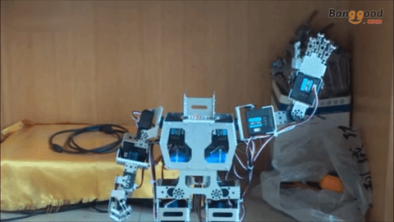
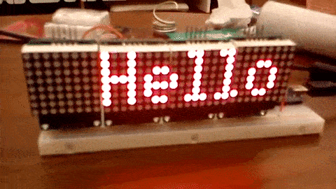
ARDUINO
The concept behind the development of Arduino is to simplify the construction of interactive objects or environments and make them more accessible.

Slide 29

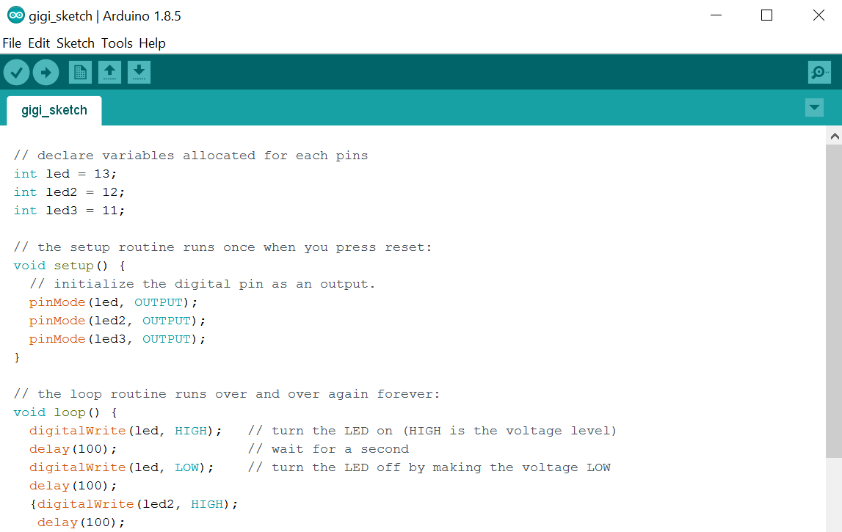

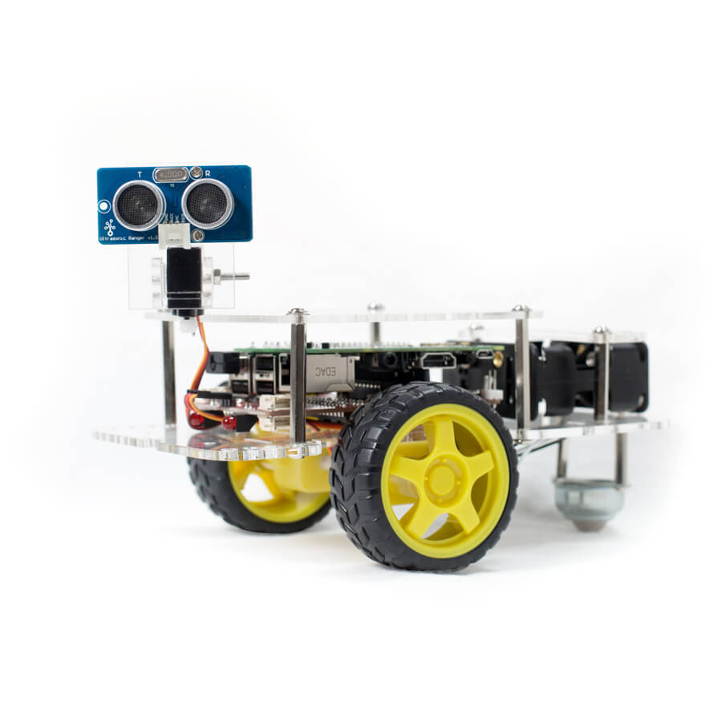
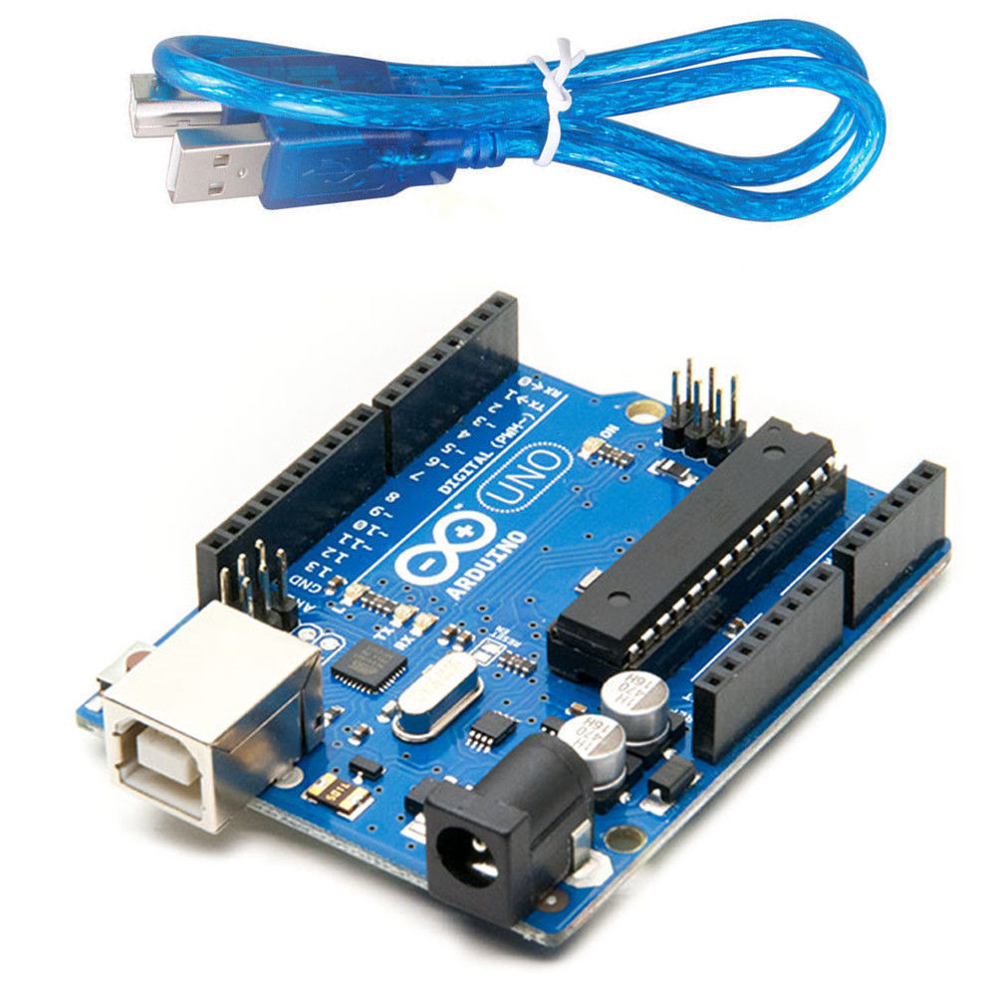
ARDUINO
The Arduino Integrated Development Environment - or Arduino Software (IDE) - contains a text editor for writing code, a message area, a text console, a toolbar with buttons for common functions and a series of menus. It connects to the Arduino and Genuino hardware to upload programs and communicate with them.

Slide 30
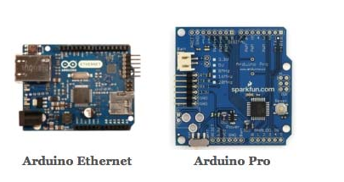
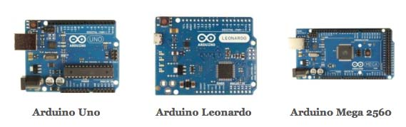
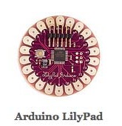
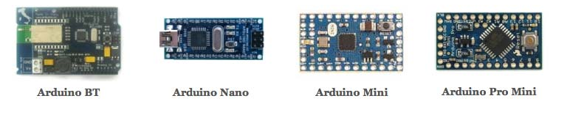
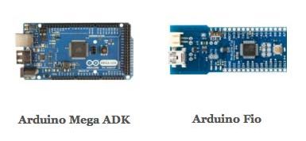
ARDUINO - TYPES

Slide 31
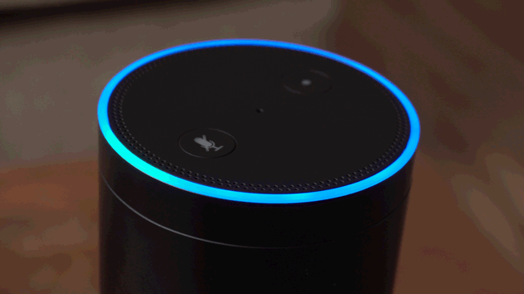
AMAZON ALEXA
Alexa is Amazon’s cloud-based voice service available on tens of millions of devices from Amazon and third-party device manufacturers.
With Alexa, you can build natural voice experiences that offer customers a more intuitive way to interact with the technology they use every day.
With collection of tools, APIs, reference solutions, and documentation make it easy for anyone to build with Alexa.

